Slide 1
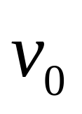
Example
m,λ
m
v_{cm}

Slide 2
Example
m,λ
m
v_{cm}

Slide 3
Example
m,λ
m
v_{cm}

Slide 4
Example
m,λ
m
v_{cm}

Slide 5
Example
m,λ
m
v_{cm}

Slide 6
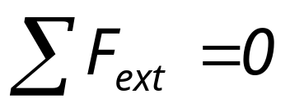
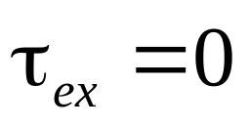
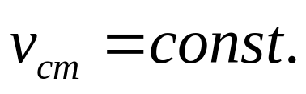

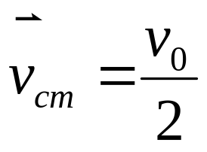
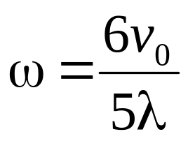
Example
cm Frame
m,λ
m
m
v_{cm}

Slide 7
m
cm Frame
c
m

Slide 8
m
cm Frame
c
m

Slide 9
m
cm Frame
c
m

Slide 10
m
cm Frame
c
m

Slide 11
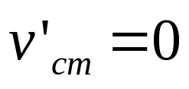

cm Frame
c

Slide 12
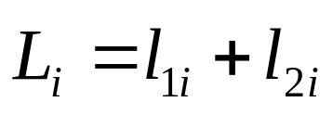
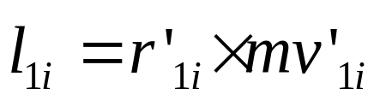
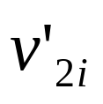
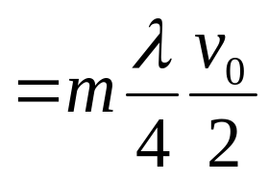
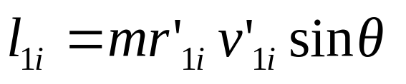
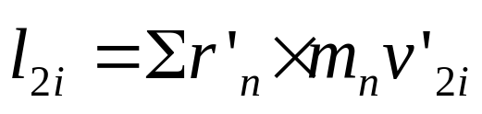
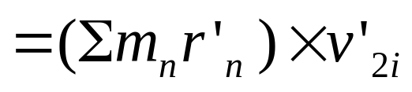
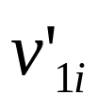
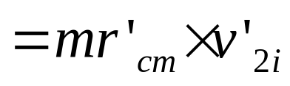
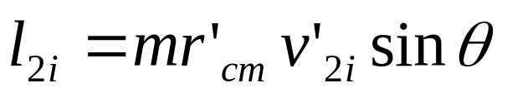
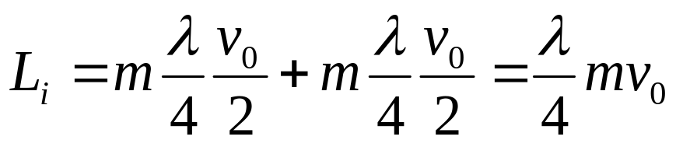
m
θ
θ
c
m

Slide 13
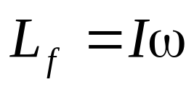
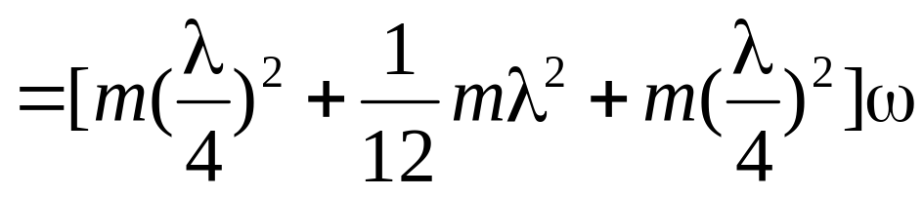
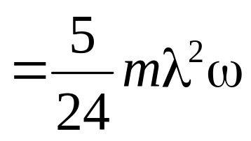
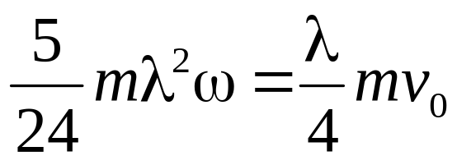
m
c
c

Slide 14


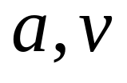
A solid ball with mass m and radius r
Example
r<<R
Rolling without slipping

Slide 15
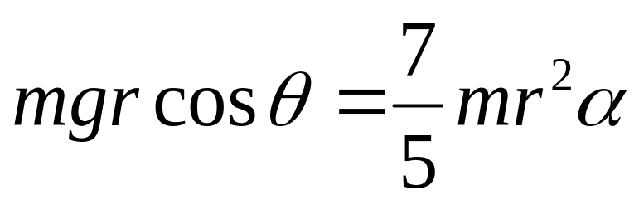
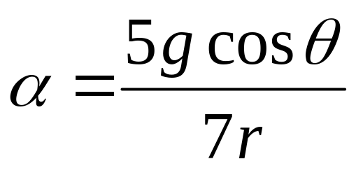
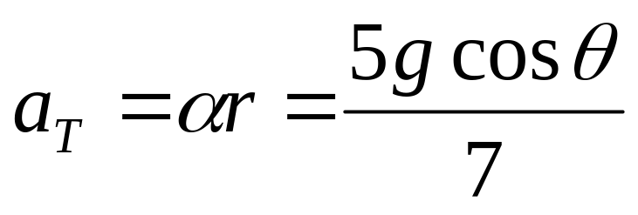
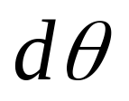
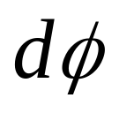
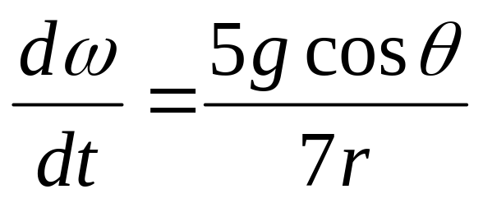
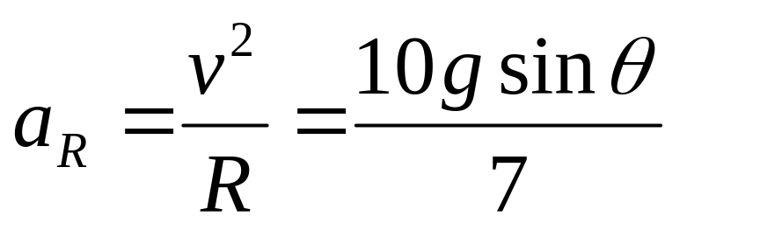
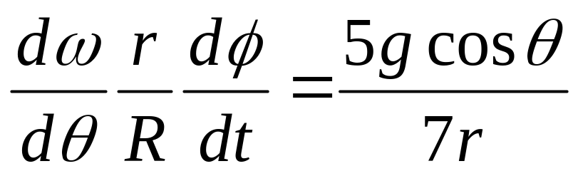
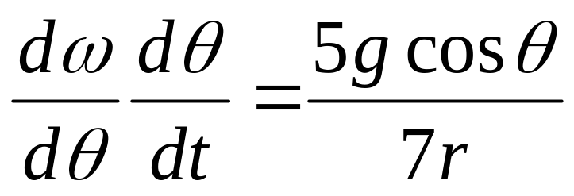
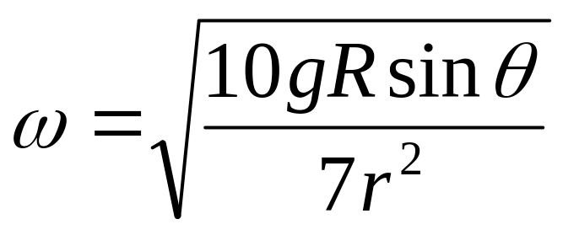
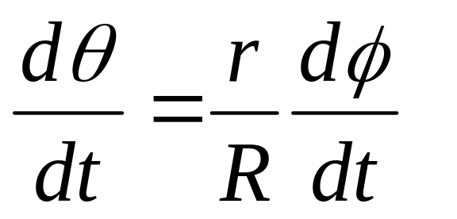
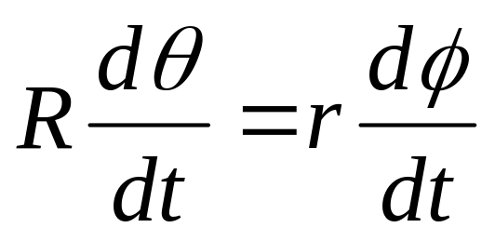
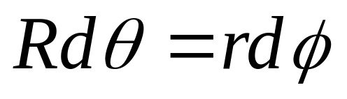
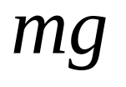
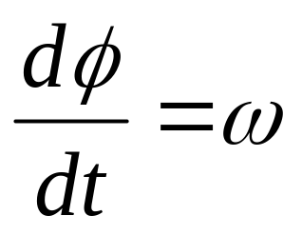
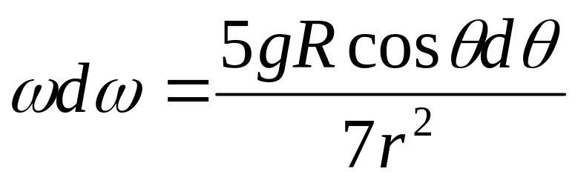
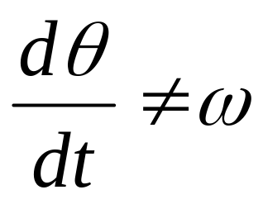
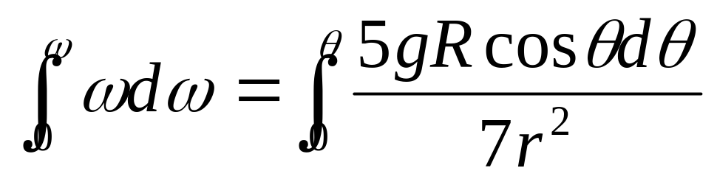
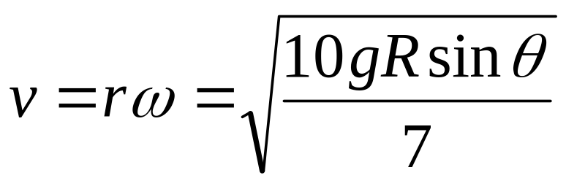
Example

Slide 16
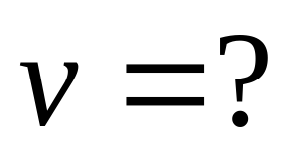
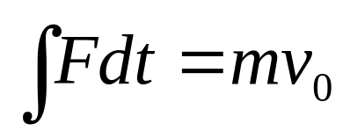
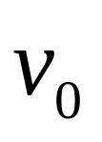
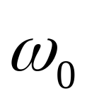
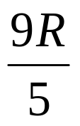
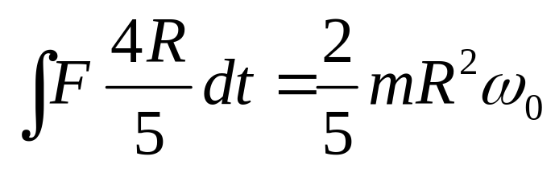


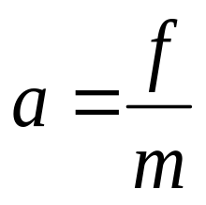
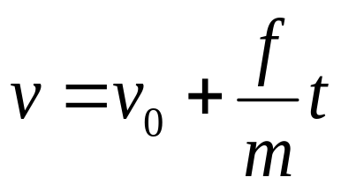











Impulse
Example
Angular Impulse

Slide 17

Example

Slide 18




Example
Impulse
Angular Impulse

Slide 19









Example

Slide 20








Example
Impulse
Angular Impulse

Slide 21
Chapter 11
Work and Kinetic Energy

Slide 22



Work done by a constant force

Slide 23



Work done by a constant force

Slide 24



Power
The unit of power in SI unit is the joule per second, which is called the watt (W).

Slide 25










Work done by a variable force .
(One dimensional case)
When N→∞，δx_{n}→0

Slide 26





Example:
F = - kx.

Slide 27








Two dimensional case

Slide 28










Kinetic energy and work-energy theorem
Kinetic energy

Slide 29




Kinetic energy in collisions
Elastic collisions

Slide 30




Kinetic energy in collisions
Inelastic collisions

Slide 31


Kinetic energy in collisions
Explosive

Slide 32













Work and kinetic energy in rotational motion
work
power
Rotational kinetic energy

Slide 33






Review
Translational Quantity
Rotational Quantity
Work
Power
Kinetic energy

Slide 34














Translation and rotation
y
y’
c
o
m_{n}
König theorem

Slide 35
CHAP. 11
Exercises
21, 22 (P250)
23, 30, 36 (P251)

